Slide 1

FOR PURPOSE OF FORAGE VIRTUAL INTERNSHIP PROGRAM
CUSTOMER REVIEW ANALYSIS
18.12.2023

Slide 2
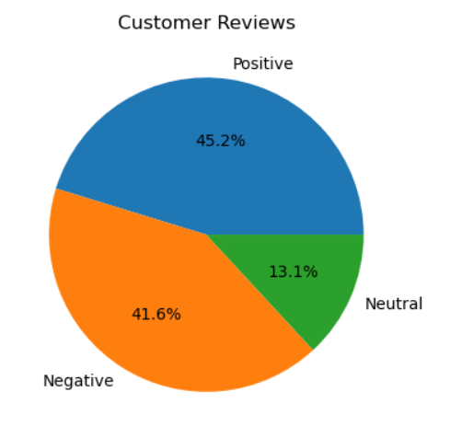
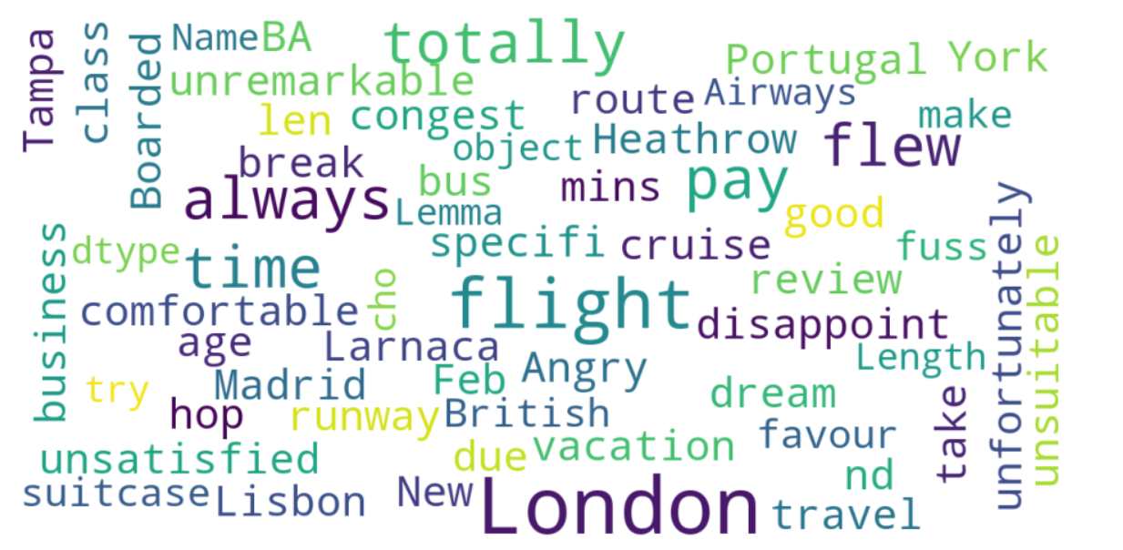
CUSTOMER INSIGHTS
PIE CHART | WORDCLOUD
FROM 220 CUSTOMERS WE EXTRACTED REVIEWS
POSTIVE REVIEWS 100
NEGATIVE REVIEWS 92
NEUTRAL REVIEWS 29

